Slide 2
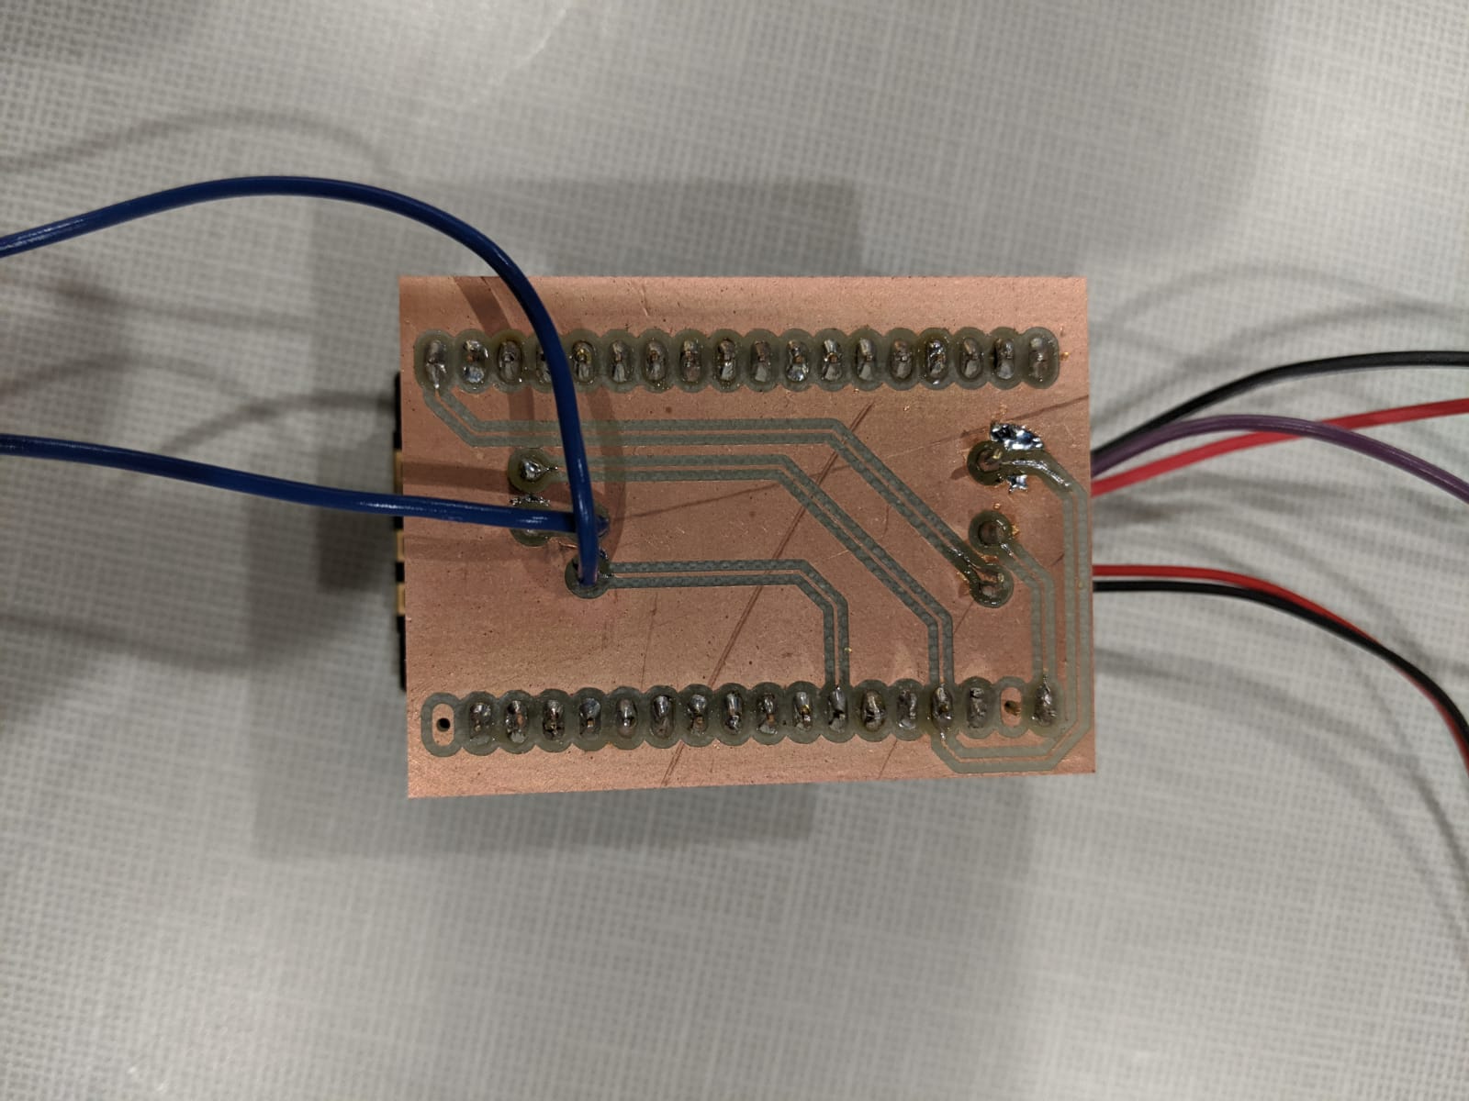
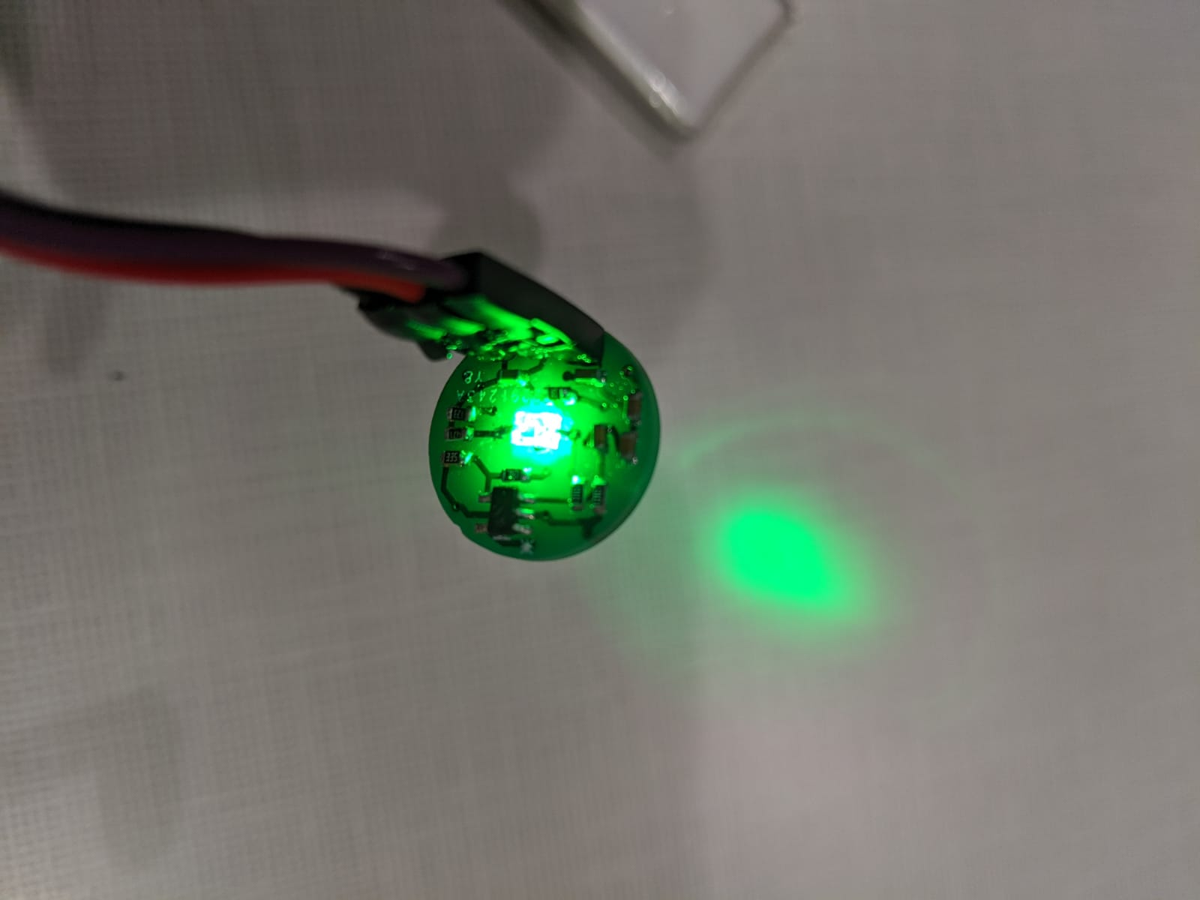
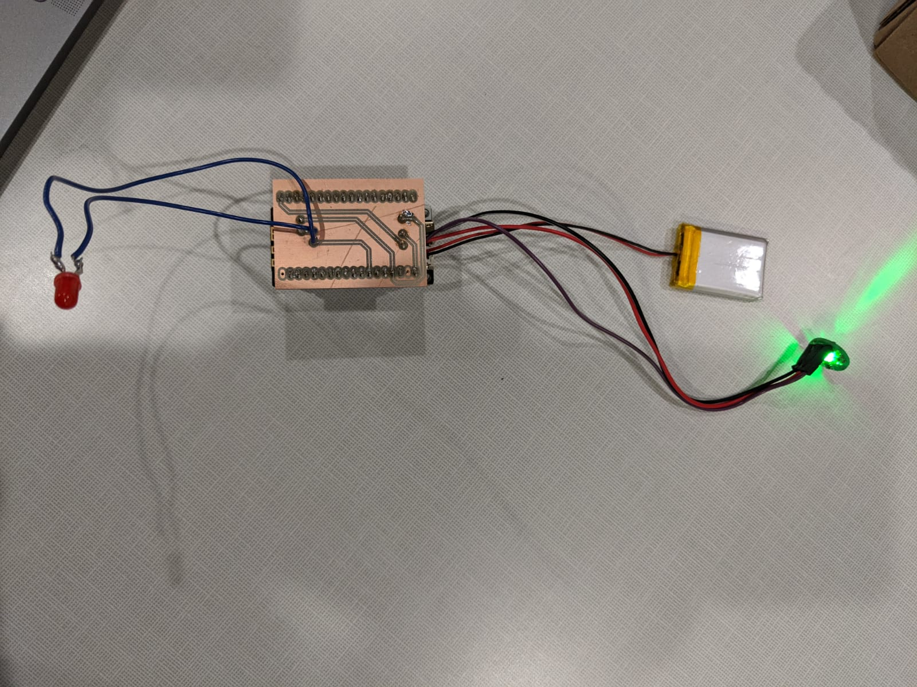
Prototyping

Slide 3
Prototyping

Slide 4
QUESTIONS
College of Name | Department of Name

